Slide 1

CAPSTONE PROJECT – 4
UNSUPERVISED MACHINE LEARNING
CUSTOMER SEGMENTATION ONLINE RETAIL
Presented by –
Sana Mulani

Slide 2
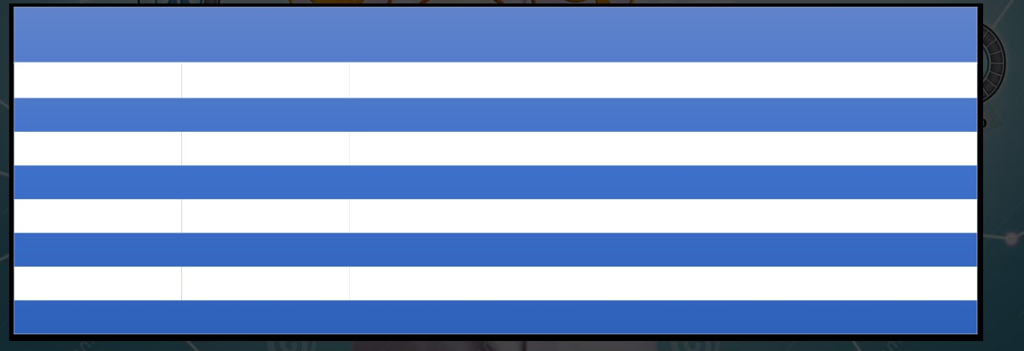
INTRODUCTION
1. The main goal is to identify customers that are most profitable and the ones who
churned out to prevent further loss of customer by redefining company policies.
2. CLUSTER ANALYSIS: Statistically Segment Customers into groups Observation by using the
features given below
Data Description
Attribute Data Type Description
Invoice Number
Nominal
6-digit unique number / code starts with letter 'c', it indicates a cancellation
Stock Code
Nominal
a 5-digit unique number assigned to each distinct product.
Description
Nominal
Product (item) name
Quantity
Numeric
Quantities of each product (item) per transaction
Invoice Date
Numeric
Date and time when each transaction was generated
Unit Price
Numeric
Product price per unit in sterling.
CustomerID
Nominal
5-digit unique number for Customer
Country
Nominal
the name of the country where each customer resides.

Slide 3
IMPORTING AND INSPECTING DATASET
Data set Name:- Online Retail
No of Observation:541908 (shape=8x541908)
dtypes: datetime=(1), float64=(2), int64=(1), object=(4) 1+2+1+4 = 8 columns
Data Cleaning
Checking Missing data
1. CustomerID - 135080(25% Missing Values)
No use of this data it can be dropped
2. Description - 1454 (0.27% Missing Values)
Checking duplicates
5268 data points were duplicated
Dropped duplicates
Total data points left
No of Observation left :401604 (shape=8x 401604)

Slide 4
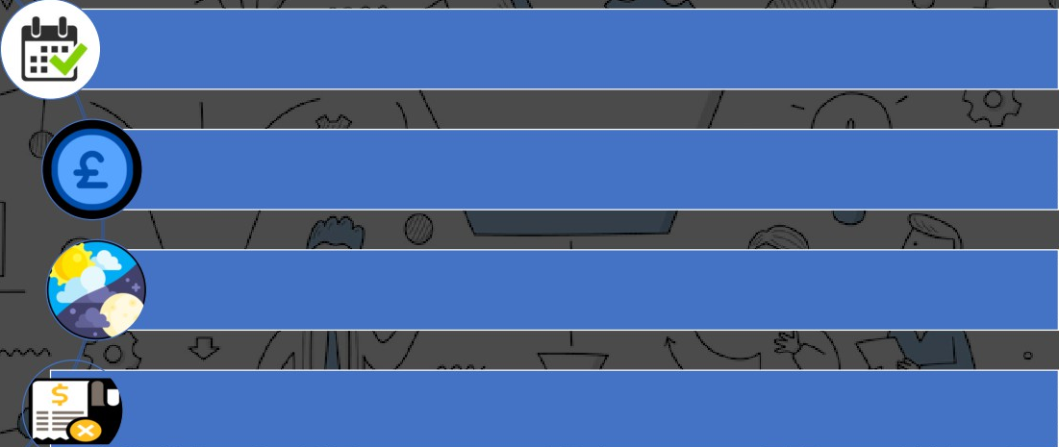
FEATURE ENGINEERING
Extracting year Date and Month from Invoice Date
Added Feature 'TotalAmount' by multiplying values from the Quantity and UnitPrice column.(Sterling)
Added feature 'TimeType' based on hours to define whether its Morning, Afternoon, or Evening
Dropping InvoiceNo starting with 'C’ that represents cancellation

Slide 5
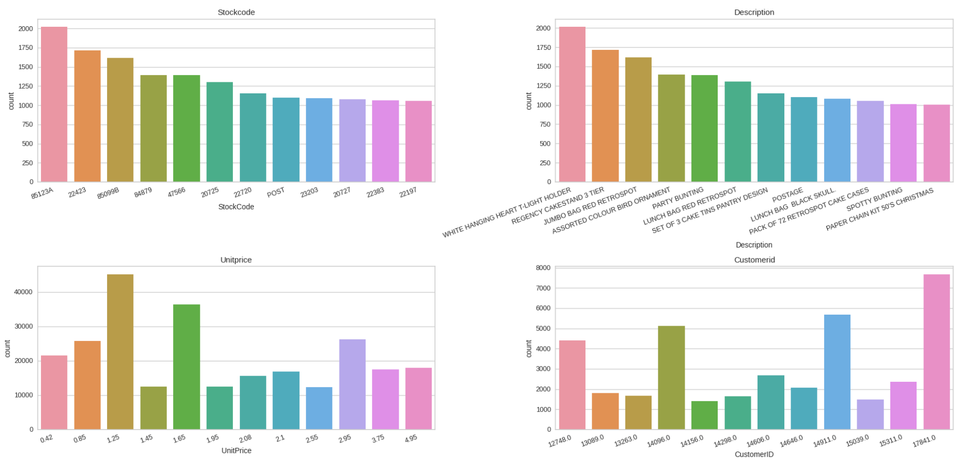
MOST FREQUENT VALUES

Slide 6
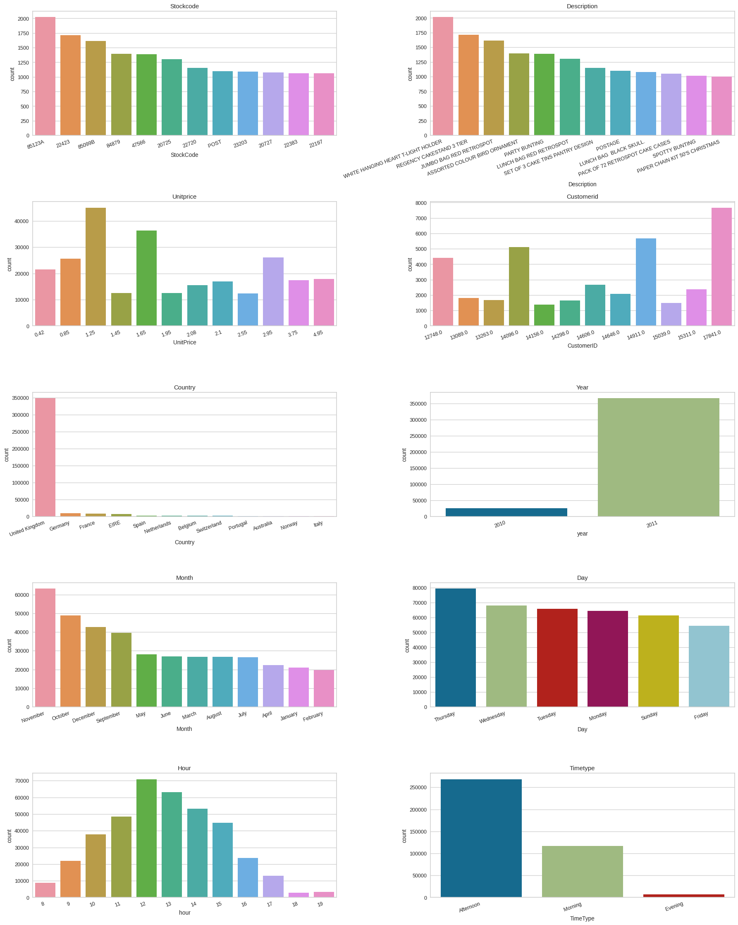
MOST FREQUENT VALUES

Slide 7
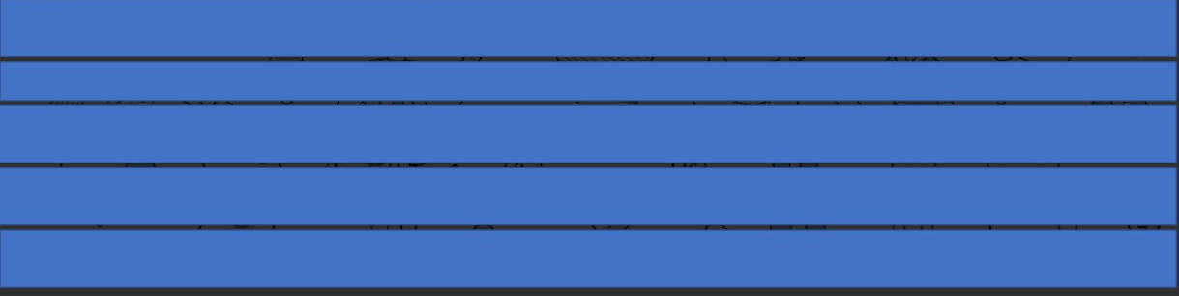
MOST FREQUENT VALUES
Observations/Hypothesis
1. Most Customers are from the United Kingdom. A considerable number of customers are also from Germany, France, EIRE and Spain.
2. There are no orders placed on Saturdays. Looks like it’s a non-working day for the retailer.
3. Most of the customers have purchased gifts in the month of November, October, December, and September. Less number of
customers have purchased the gifts in the month of April, January, and February.
4. Most of the customers have purchased the items in the Afternoon, moderate numbers of customers have purchased the
items in Morning and the least in the Evening.
5. WHITE HANGING HEART T-LIGHT HOLDER, REGENCY CAKESTAND 3 TIER, JUMBO BAG RED RETRO SPOT are the most ordered
products

Slide 8
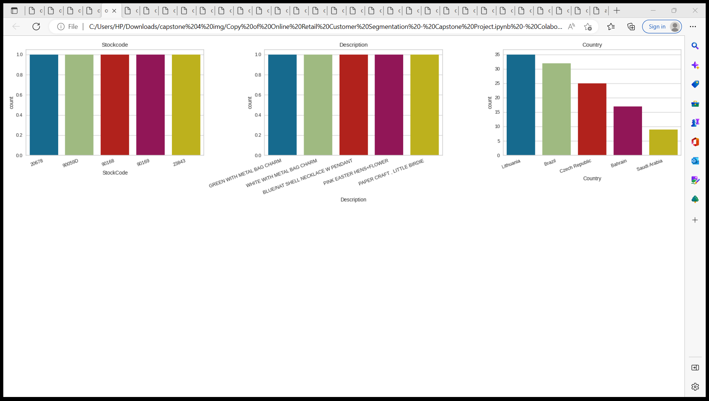
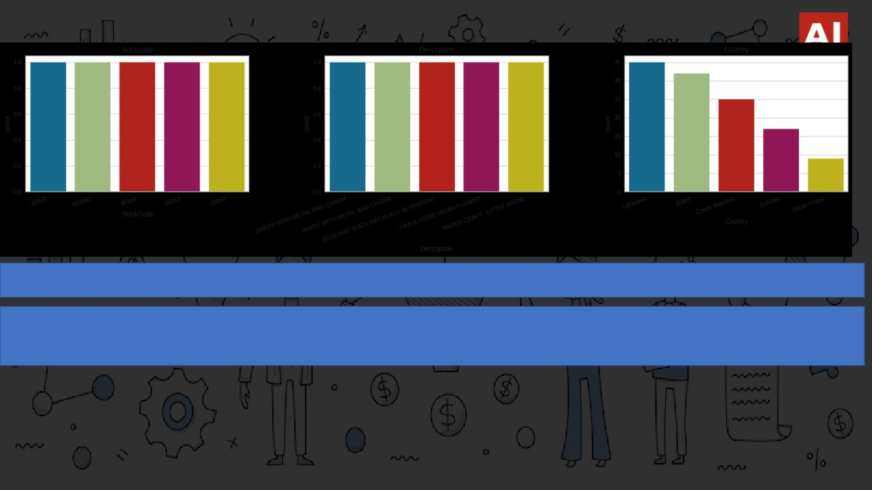
LESS FREQUENT VALUES
1. Saudi Arabia, Bahrain, the Czech Republic, Brazil, and Lithuania has the least number of customers
2. GREEN WIT METAL BAG CHARM, WHITE WITH METAL BAG CHARM, BLUE/NAT SELL NECLACE W PENDENT, PINK EASTER ENS FLOWER, PAPER CRAFT LITTLE BIRDIE are some of the least sold products.

Slide 9
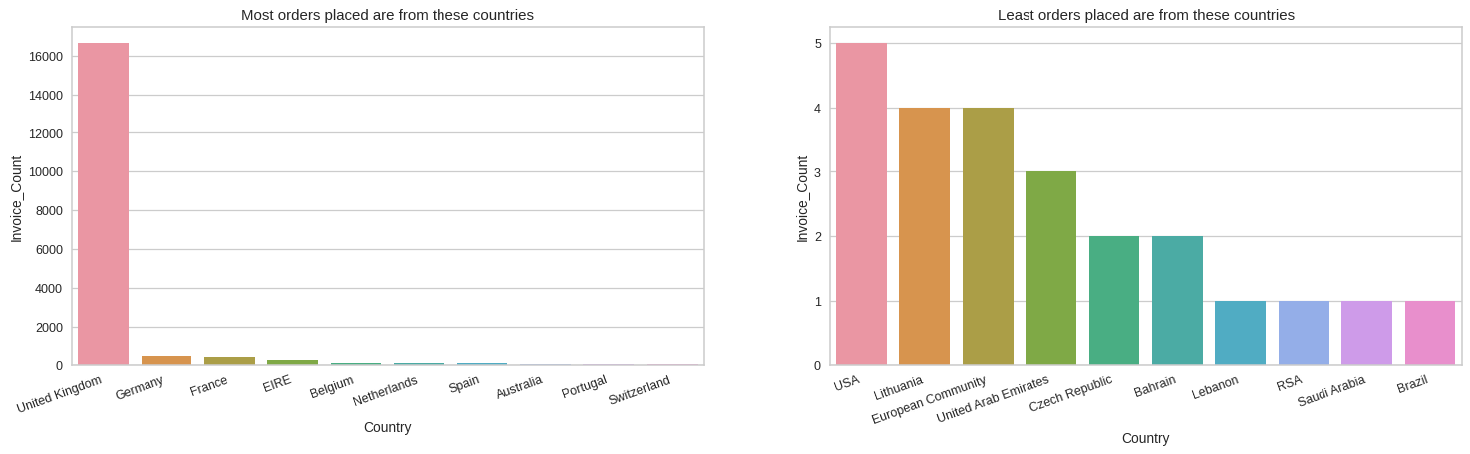
COUNTRY WISE ORDERS

Slide 10
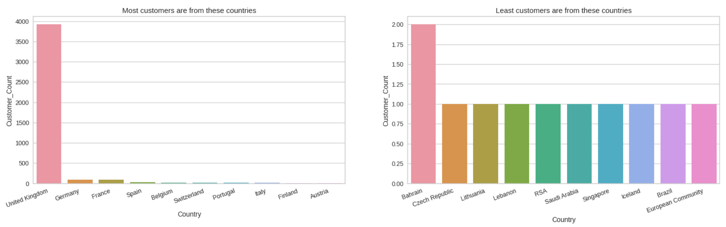
COUNTRY WISE CUSTOMERS

Slide 11
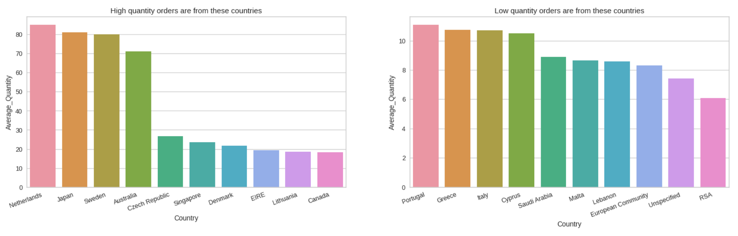
COUNTRY WISE PURCHASE QUANTITY

Slide 12
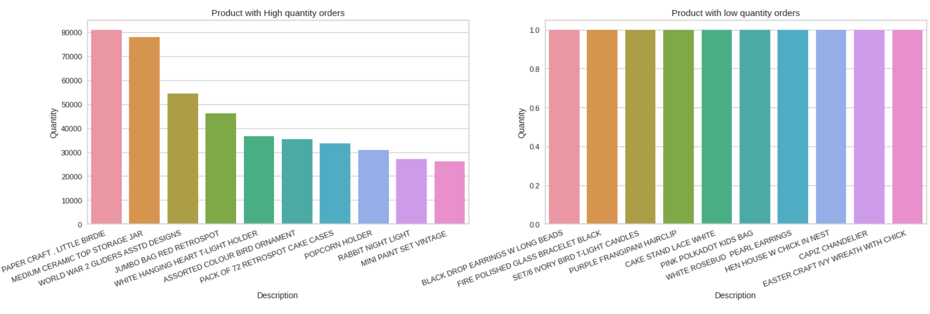
PRODUCT WISE PURCHASE QUANTITY

Slide 13
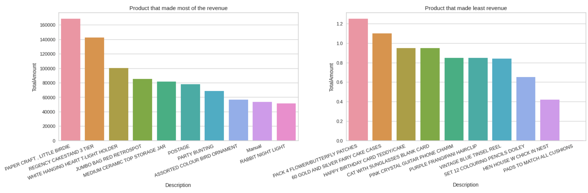
PRODUCT WISE REVENUE

Slide 14
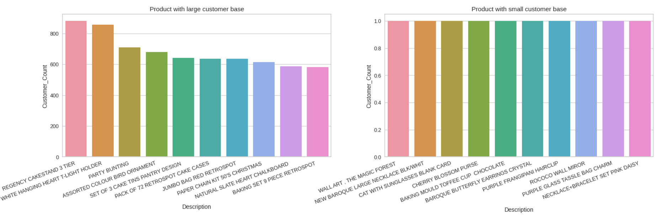
PRODUCT WISE CUSTOMERS

Slide 15
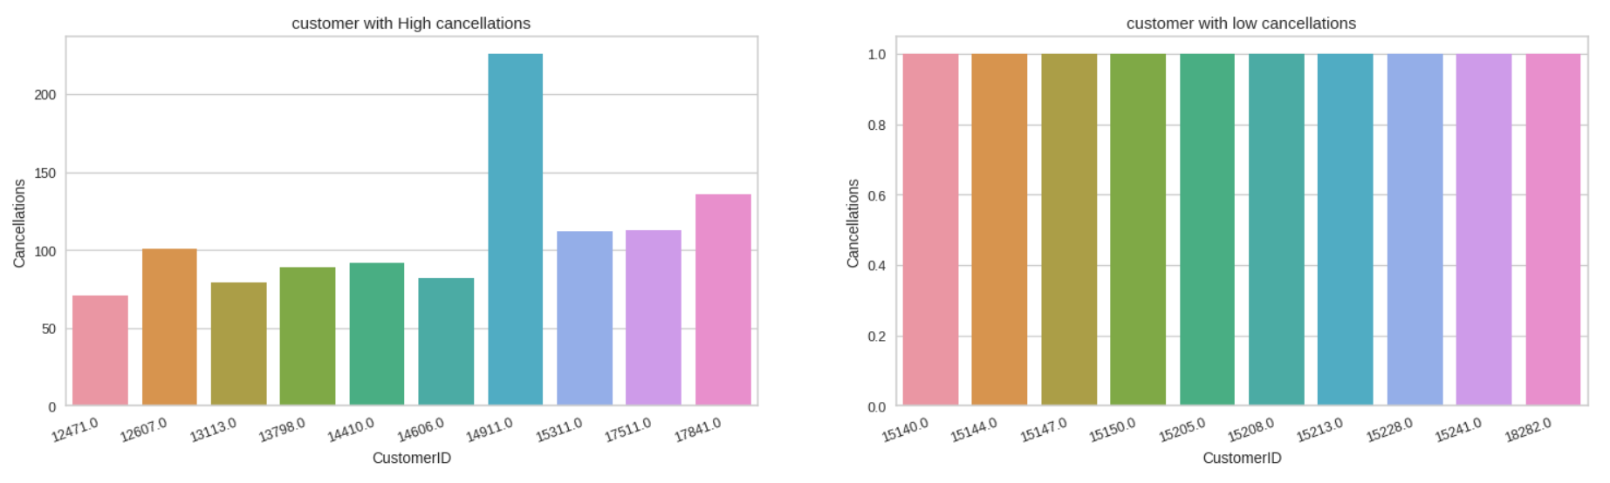
CUSTOMER WISE CANCELLATIONS

Slide 16
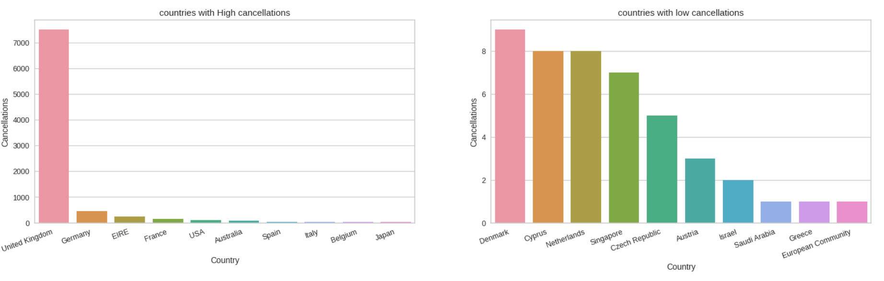
COUNTRY WISE CANCELLATIONS

Slide 17
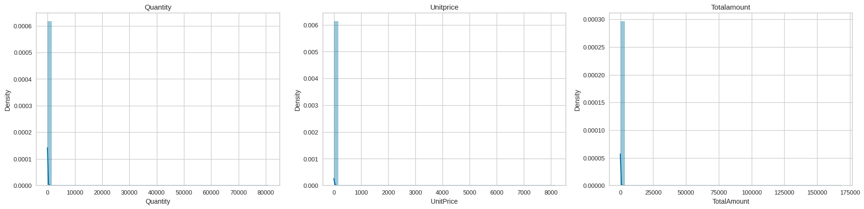
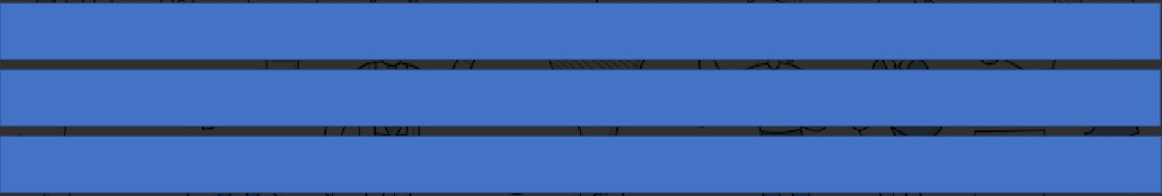
VISUALIZING DISTRIBUTIONS
1. Visualizing the distribution of quantity, unitprice and total amount columns
2. It shows a positively skewed distribution because most of the values are clustered around the left side of the distribution while the right tail of the distribution is longer, which means mean>median>mode
3. For symmetric graph mean=median=mode.

Slide 18
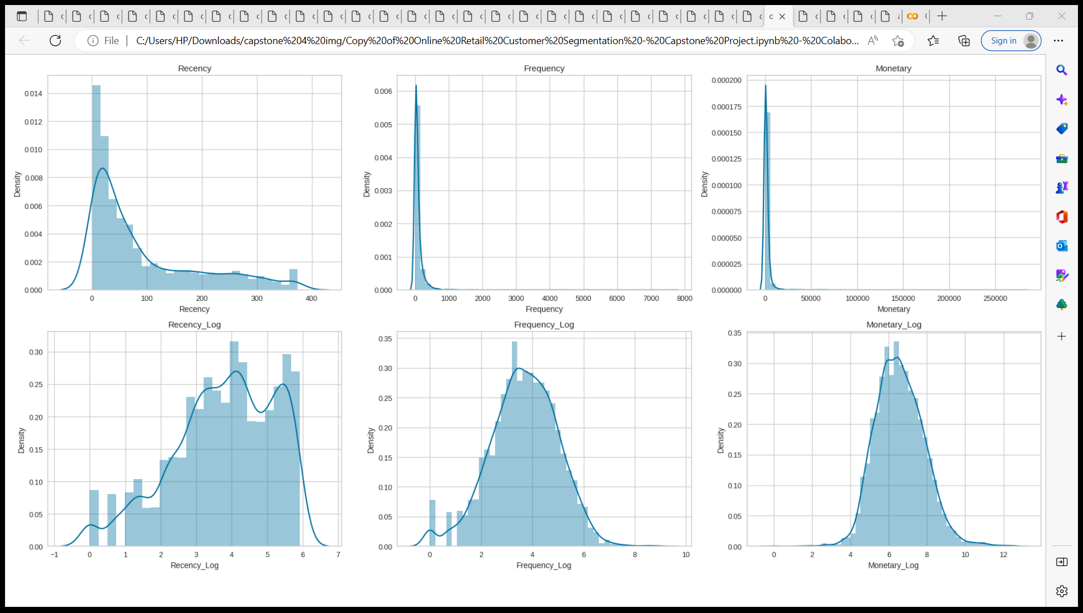
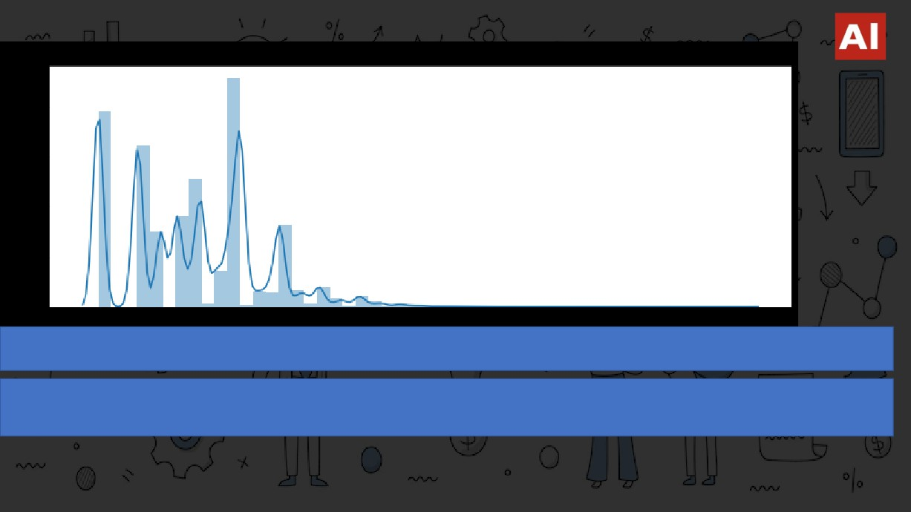
LOG TRANSFORMATION
1. After applying log transformation now the distribution plot looks comparatively better than being skewed.
2. We use log transformation when our original continuous data does not follow the bell curve, we can log transform this data to make it as “normal” as possible so that the analysis results from this data become more valid.

Slide 19

RFM ANALYSIS
How frequently do
customers visit
Money
By
Spent
Customer
Recent visit by the customers

Slide 20
RFM MODELLING
Customer Name Recency Frequency Monetary
Anthony 326 1 7183
Rahul 2 182 4310
RFM TABLE
Syed 75 31 1765
CONCLUSIONS:
Anthony
Anthony visited 326 days (approx. 1 year) ago and visited 15 times and spent
around 7183 Sterlings
Lost Potential Customer
Rahul
Recently visited Potential Customer
Rahul visited 2 days ago and visited 182 times and spent around 4310 Sterlings
Syed
About to Lose Average Customer
Syed visited 75 days ago (2.5 months)and visited 31 times and spent around
1765 Sterlings

Slide 21

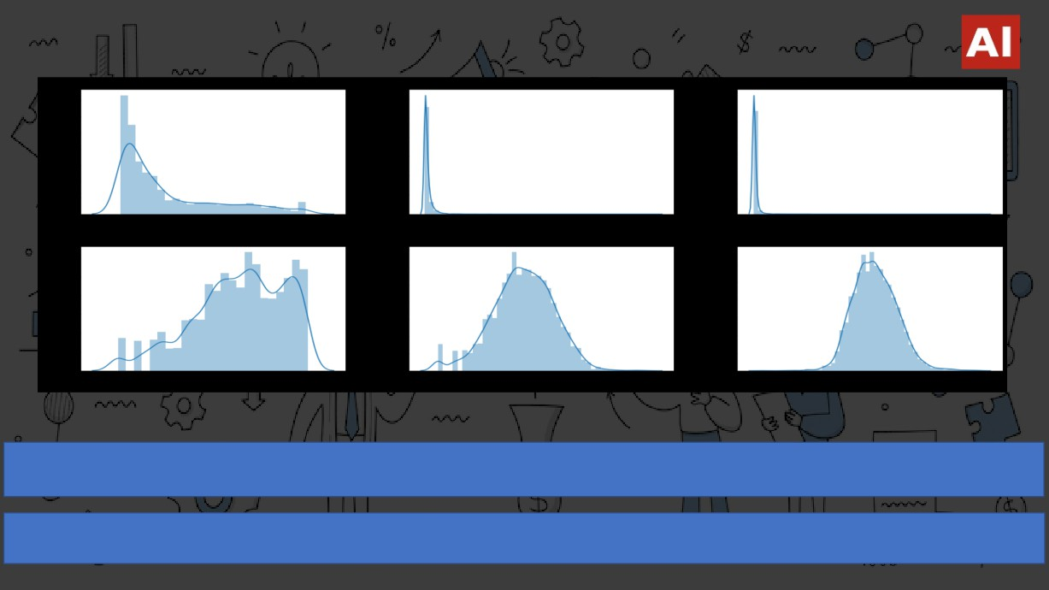
RFM MODELLING
1. Earlier the distributions of Recency, Frequency and Monetary columns were positively skewed but after applying log transformation, the distributions appear to be symmetrical and normally distributed.
2. It will be more suitable to use the transformed features for better visualization of clusters.

Slide 22
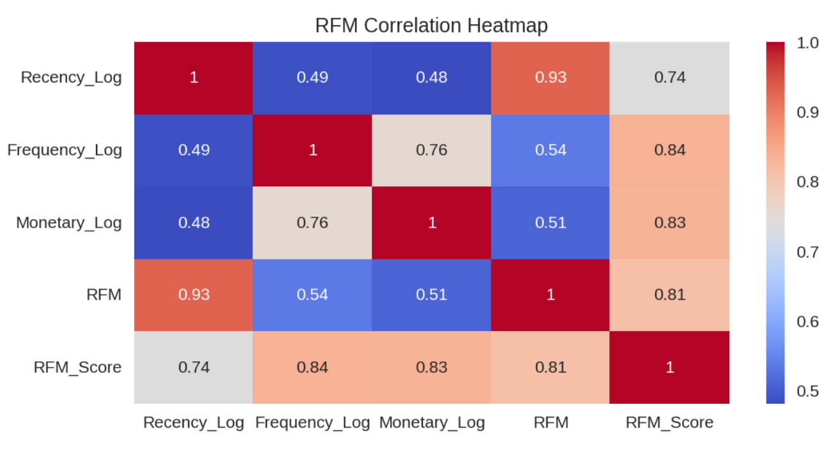
RFM CORRELATION HEATMAP
1. We can see that Recency is highly correlated with the
RFM value.
2. Frequency and Monetary are moderately correlated with the RFM.
Scaling for CLUSTERING Analysis
1. Log Transformation
2. Standard Scaler on X variables, (0)
of Features like Recency Frequency and Monetary
Modelling Clustering Analysis
mean and (1) as standard deviation
Followed by

Slide 23
Pipeline
EXTRACTING DATA
DATA CLEANING
DATA VISUALIZATION
RFM ANALYSIS
RECENCY: Must be LESS FREQUENCY: Must be MORE MONETARY: Must be MORE
Online Retail
Checking Missing data
Observation:541908
1. 25 % of items
(shape=8x541908)
(i.e 135080)
2. CustomerID - 1454
Checking duplicates
5268 data points were
Condition: For Best Customers
Duplicated
401604 DATA POINT LEFT
MODELLING
CUSTOMER SEGMENTATION
CONCLUSION
Binning (RFM SCORE)
Binning (RFM combination) K-Means
Hierarchical
DBSCAN Clustering

Slide 24
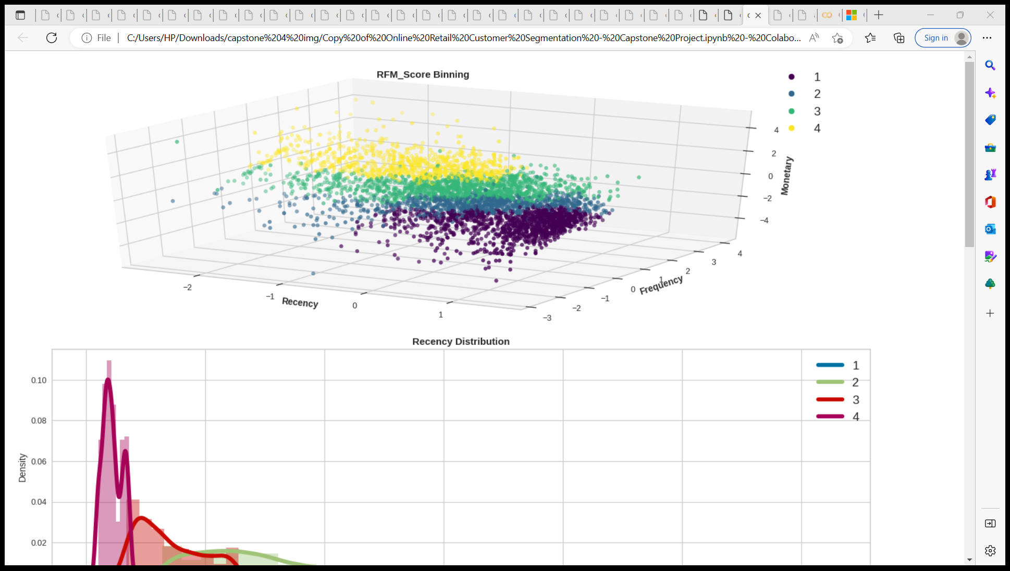
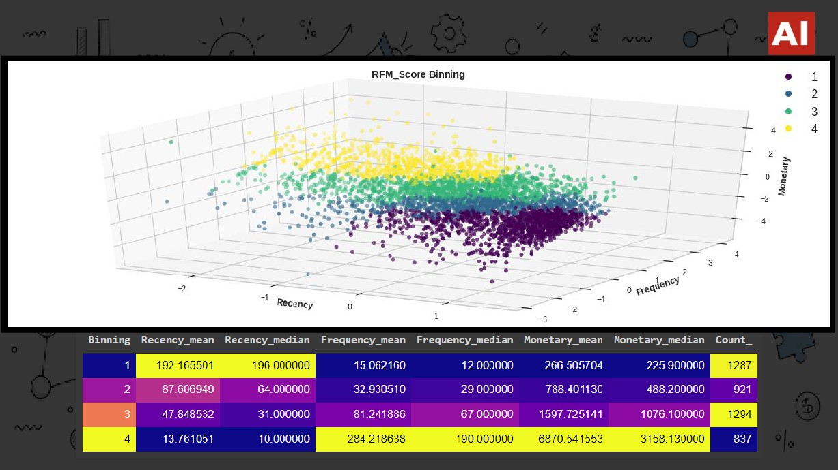
BINNING RFM SCORES

Slide 25
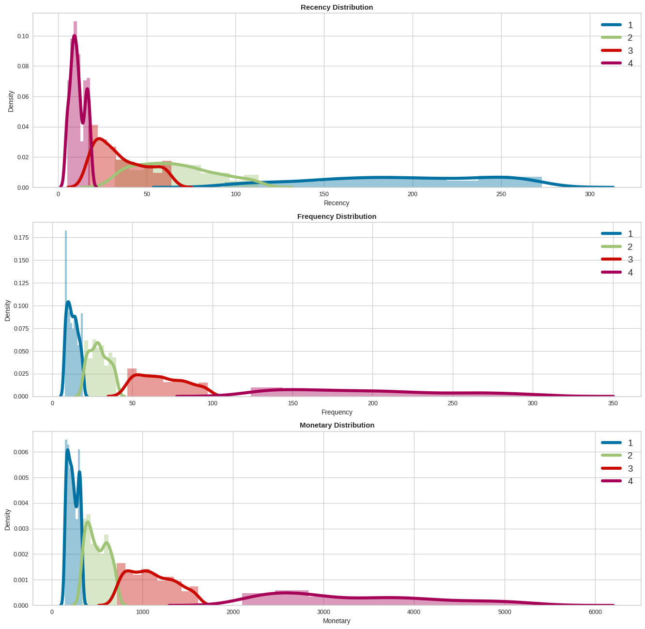
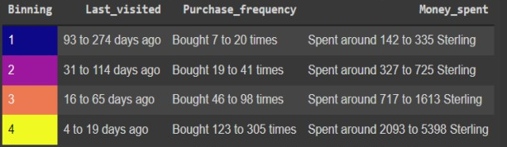
BINNING RFM SCORES
RECENCY
FREQUENCY
GROUP 1
LOST POOR CUSTOMERS
GROUP 2
AVERAGE CUSTOMERS
GROUP 3
GOOD CUSTOMERS
MONETARY
GROUP 4
BEST CUSTOMERS

Slide 26
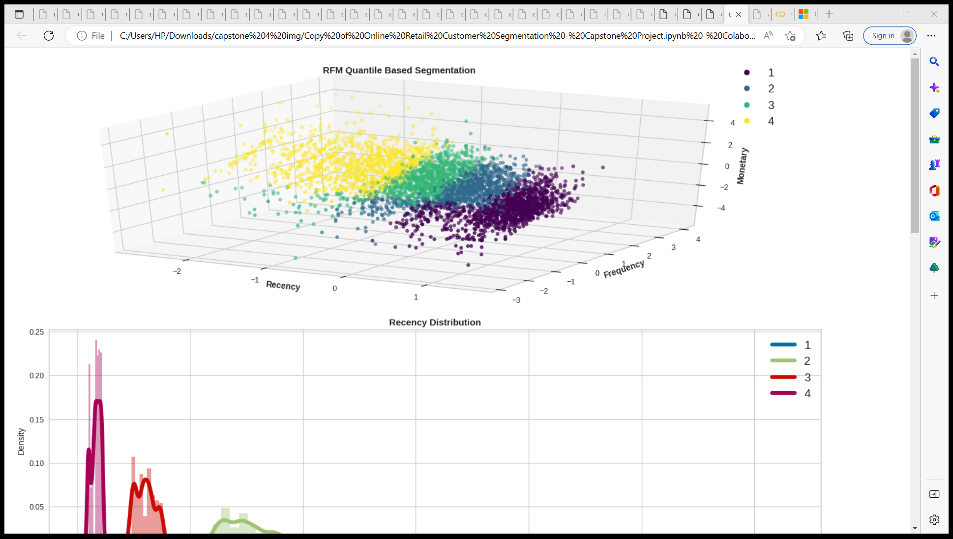
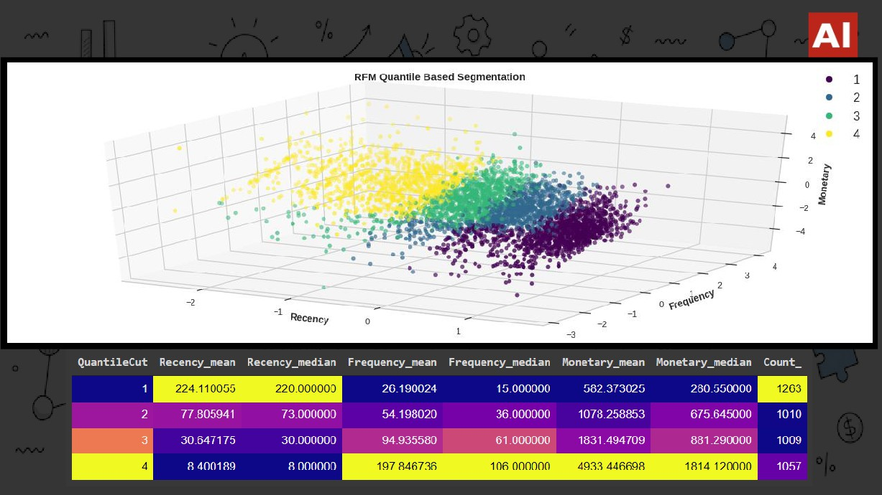
QUANTILE CUT

Slide 27
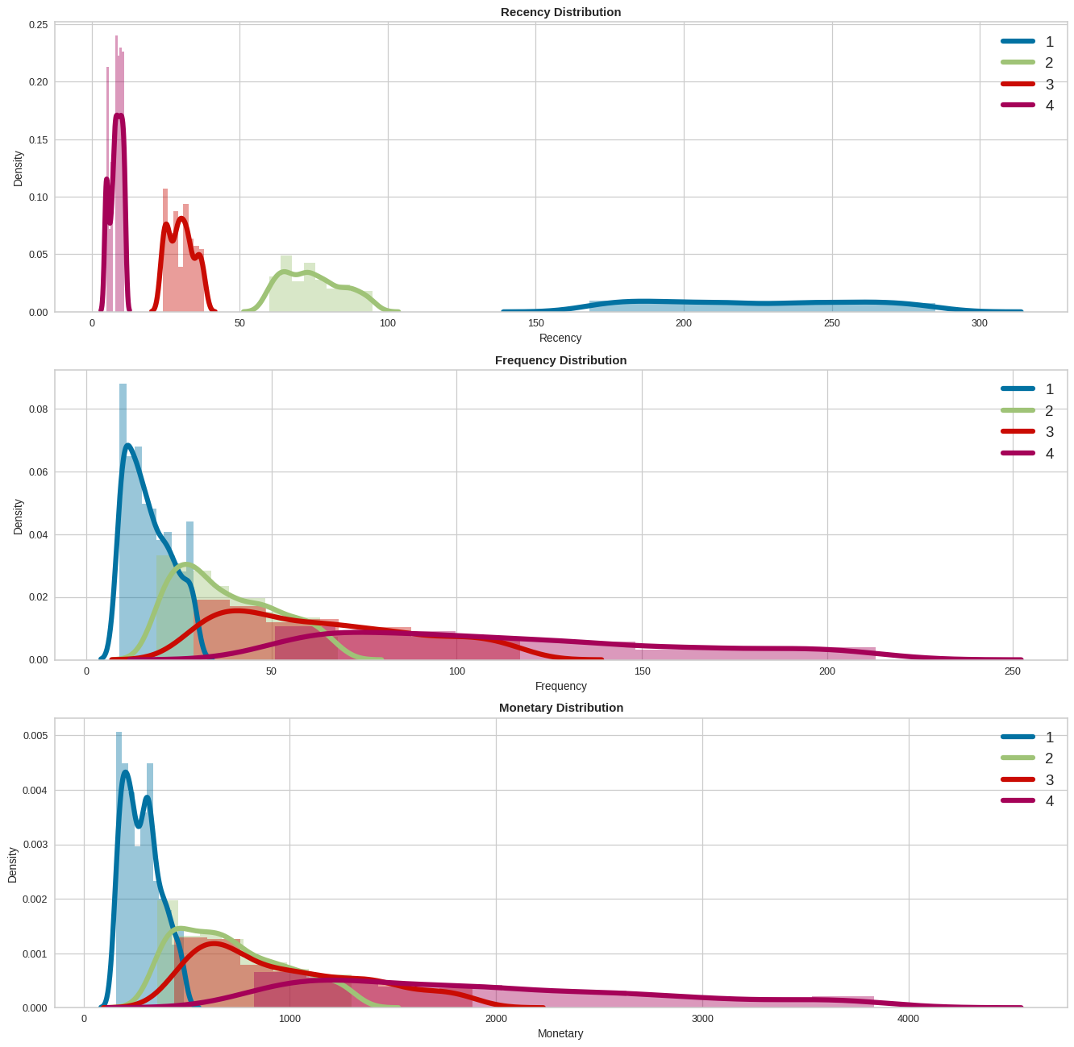
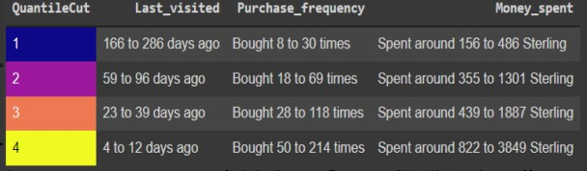
QUANTILE CUT
RECENCY
FREQUENCY
GROUP 1
LOST POOR CUSTOMERS
GROUP 2
LOSING LOYAL CUSTOMERS
GROUP 3
GOOD CUSTOMERS
MONETARY
GROUP 4
BEST CUSTOMERS

Slide 28
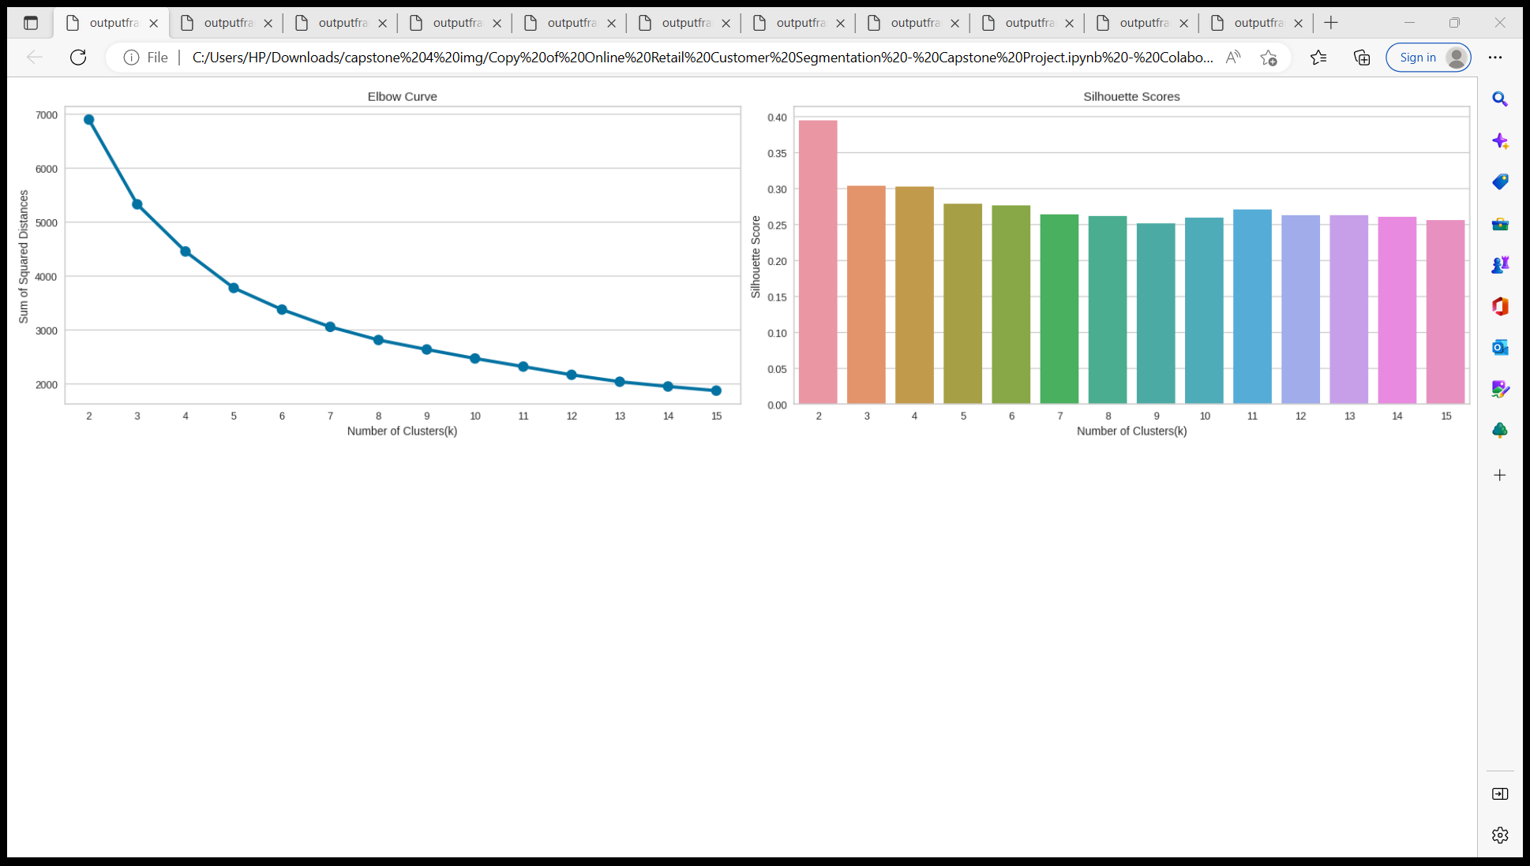
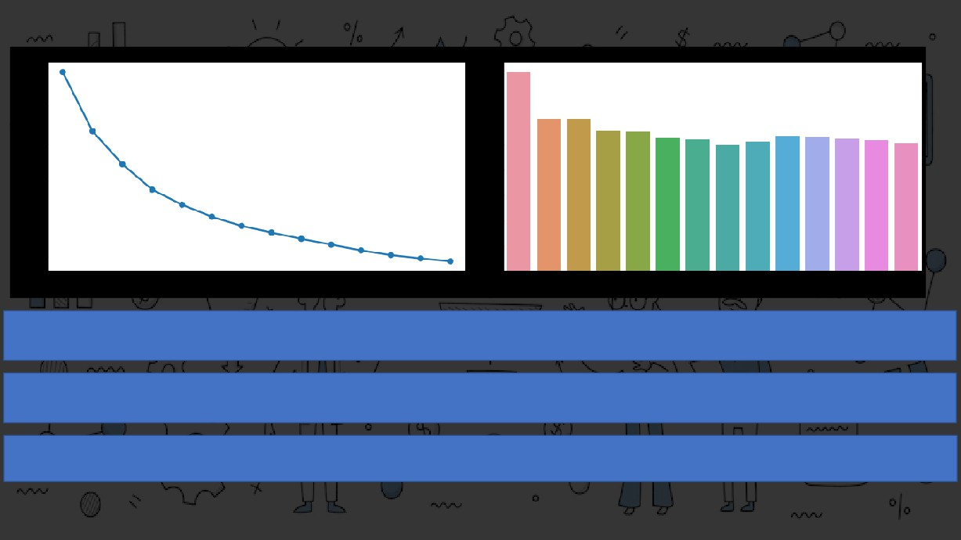
K-MEANS CLUSTERING
1. From the Elbow curve 5 appears to be at the elbow and hence can be considered as the number of clusters. n_clusters=4 or 6
can also be considered.
2. If we go by the maximum Silhouette Score as the criteria for selecting an optimal number of clusters, then n_clusters=2 can
be chosen.
3. If we look at both of the graphs at the same time to decide the optimal number of clusters, So 4 appears to be a good choice,
having a decent Silhouette score as well as near the elbow of the elbow curve.

Slide 29
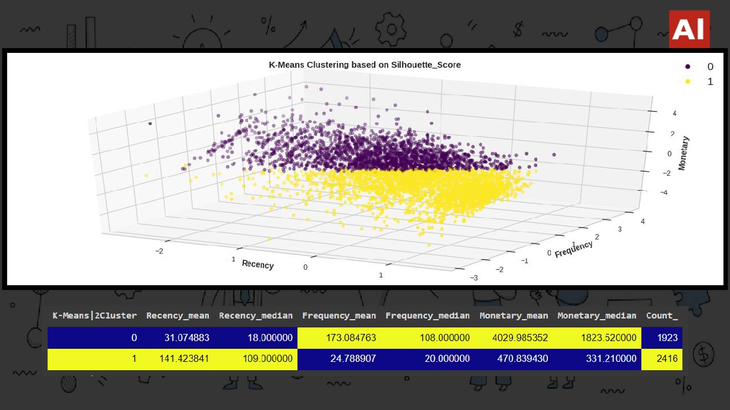
K-MEANS | 2CLUSTER

Slide 30
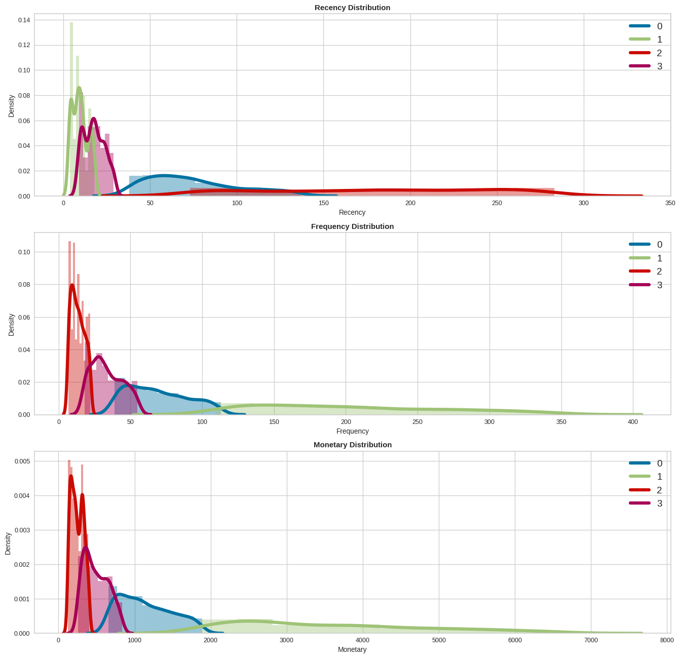
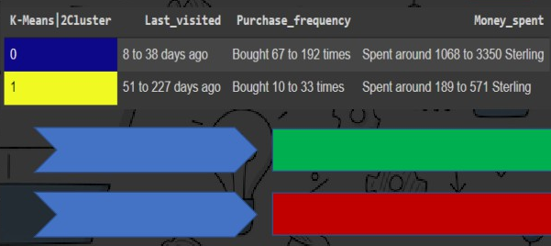
K-MEANS | 2CLUSTER
RECENCY
RECENCY
GROUP 0 BEST CUSTOMERS
FREQUENCY
GROUP 1 LOST POOR CUSTOMERS
MONETARY

Slide 31
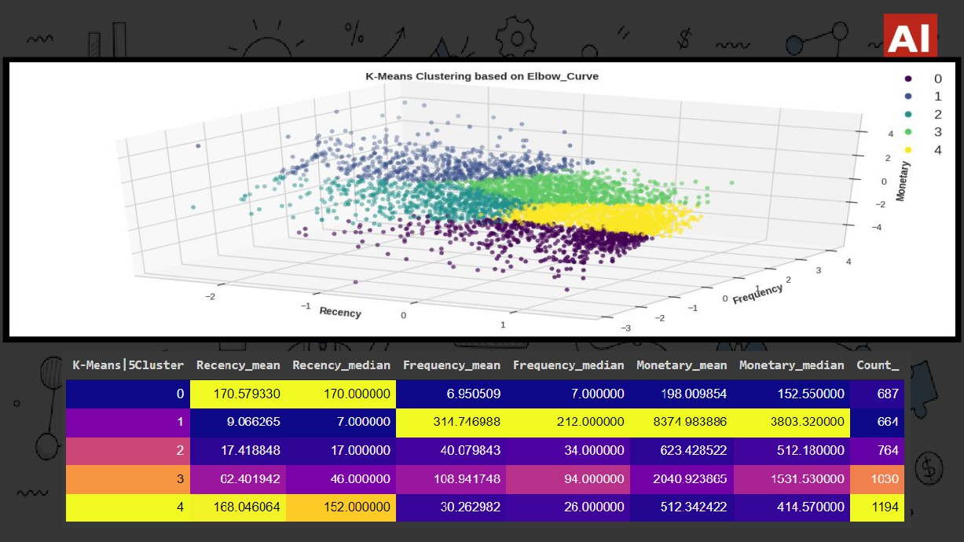
K-MEANS | 5CLUSTER

Slide 32
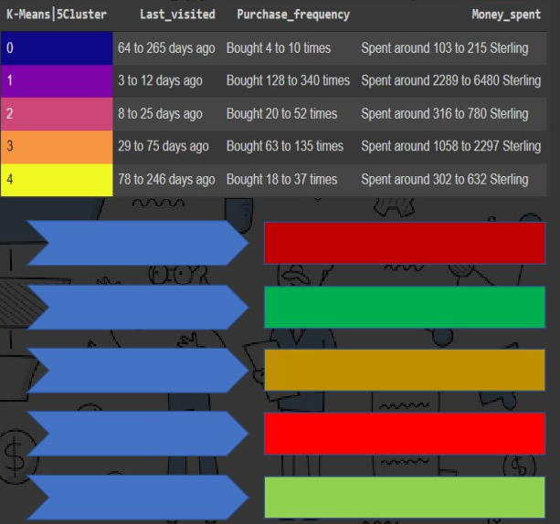
K-MEANS | 5CLUSTER
RECENCY
FREQUENCY
GROUP 0
LOST POOR CUSTOMERS
GROUP 1
BEST CUSTOMERS
GROUP 2
RECENTLY VISITED AVERAGE CUSTOMERS
MONETARY
GROUP 3
LOSING LOYAL CUSTOMERS
GROUP 4
AVERAGE CUSTOMERS

Slide 33
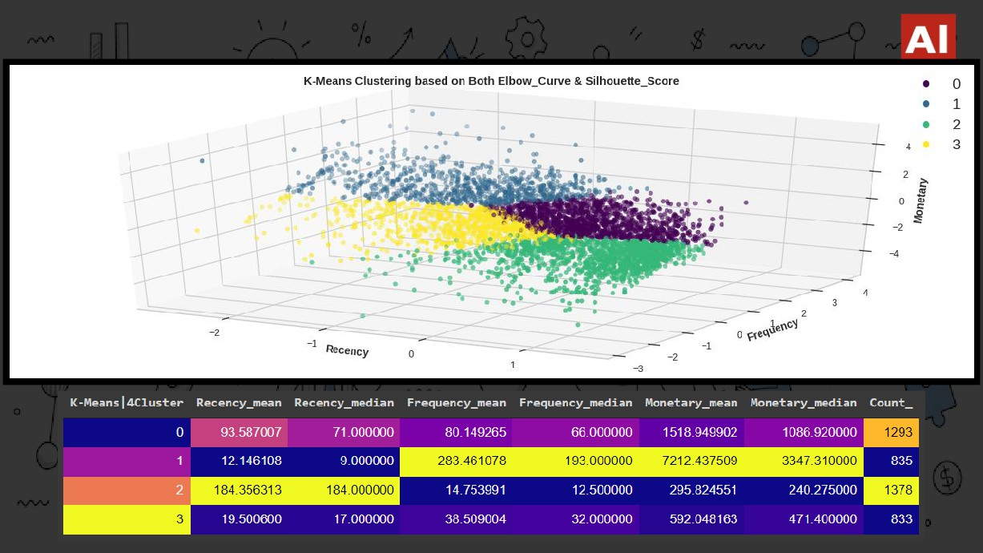
K-MEANS | 4CLUSTER

Slide 34
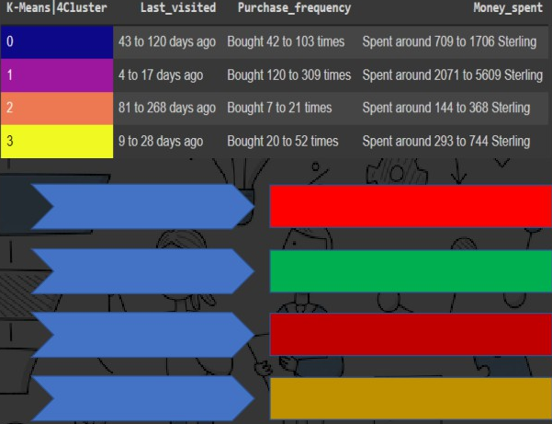
K-MEANS | 4CLUSTER
RECENCY
FREQUENCY
LOSING LOYAL CUSTOMERS
GROUP 1
BEST CUSTOMERS
GROUP 2
LOST POOR CUSTOMERS
MONETARY
RECENTLY VISITED AVERAGE CUSTOMERS

Slide 35
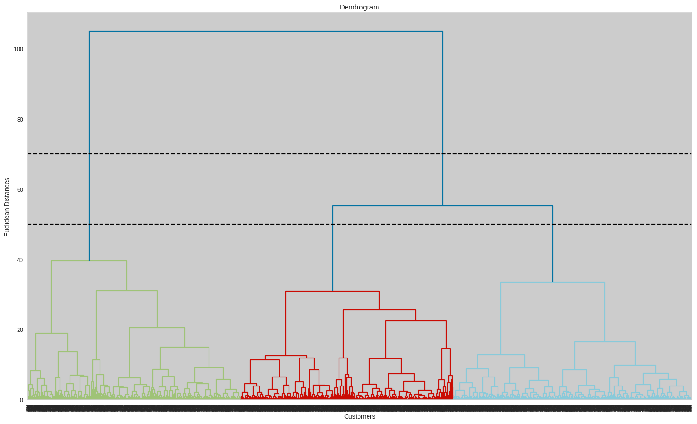
HIERARCHICAL CLUSTERING
In the K-means clustering there is a challenge to
predetermine the number of clusters, and it always tries to create the clusters of the same size. To solve these two
challenges, we can opt for the hierarchical clustering
algorithm because, in this algorithm, we don't need to
have knowledge about the predefined number of clusters. Hierarchical clustering is based on two techniques:
a. Agglomerative: Agglomerative is a bottom-up approach, in which the
algorithm starts with taking all data points as single clusters and merging them until one cluster is left.
b. Divisive: Divisive algorithm is the reverse of the agglomerative algorithm as it is a top-down approach.
We have defined the optimal number of clusters based on dendrogram as shown here

Slide 36
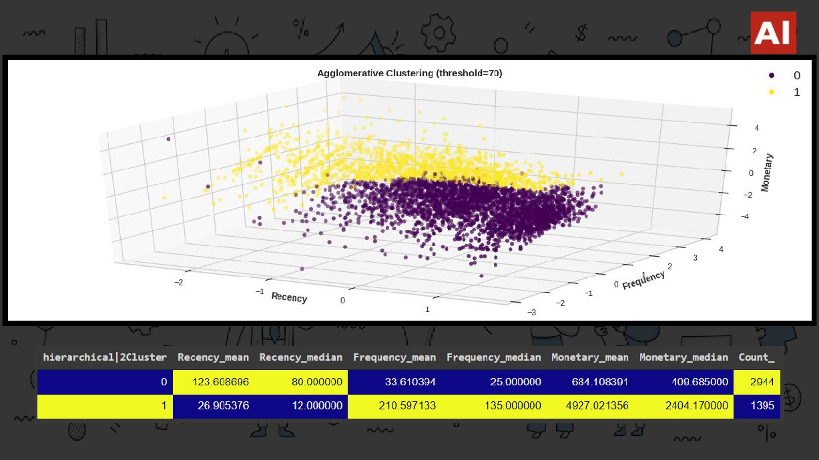
HIERARCHICAL | 2CLUSTER

Slide 37
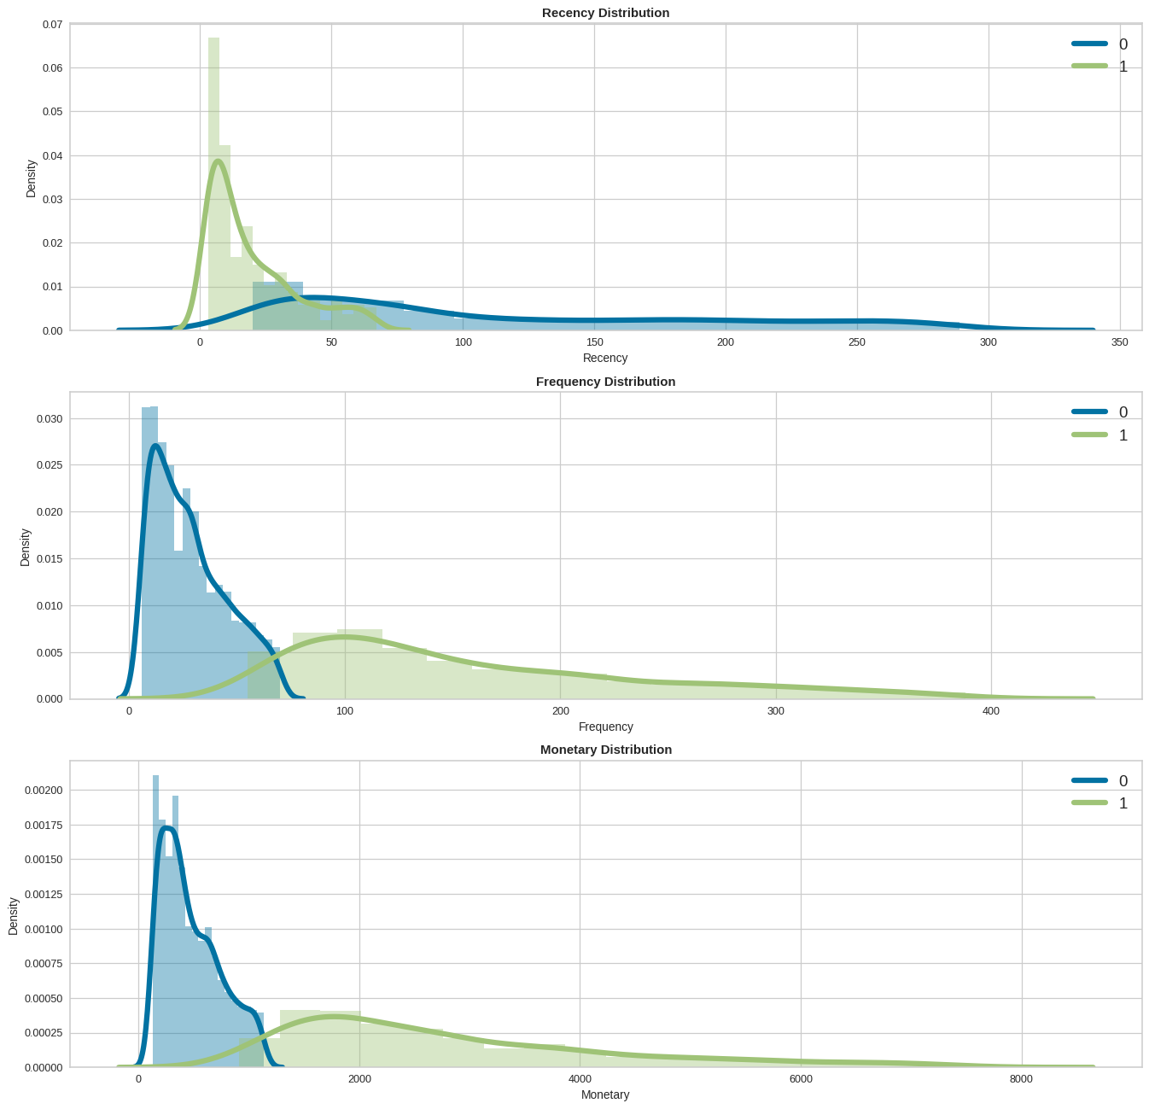
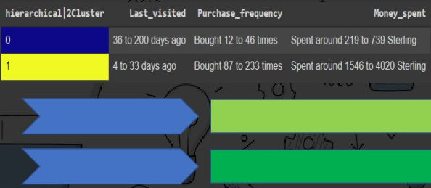
HIERARCHICAL | 2CLUSTER
RECENCY
GROUP 0 AVERAGE CUSTOMERS
FREQUENCY
GROUP 1 BEST CUSTOMERS
MONETARY

Slide 38
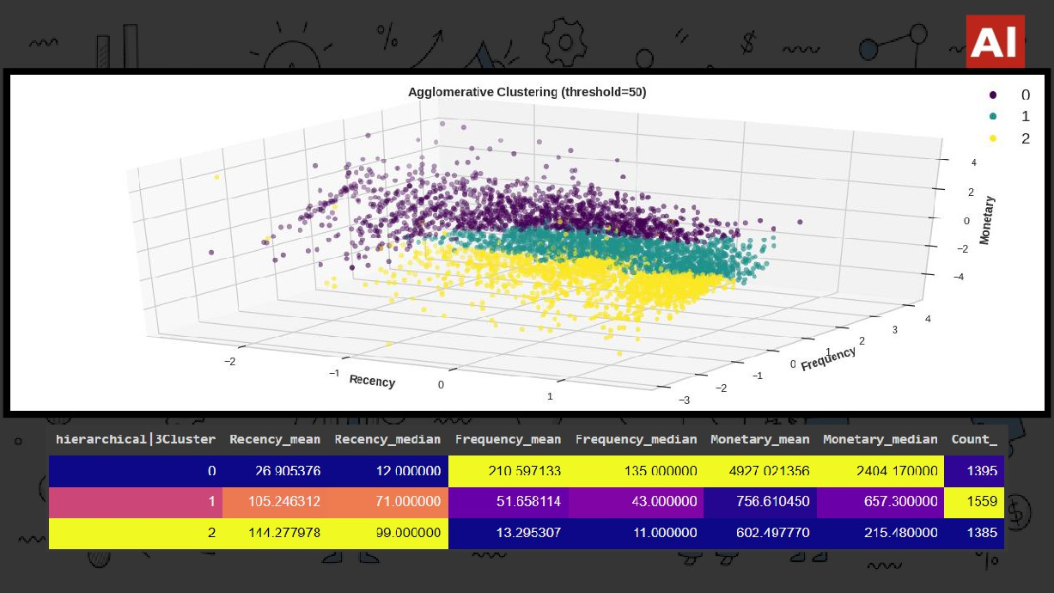
HIERARCHICAL | 3CLUSTER

Slide 39
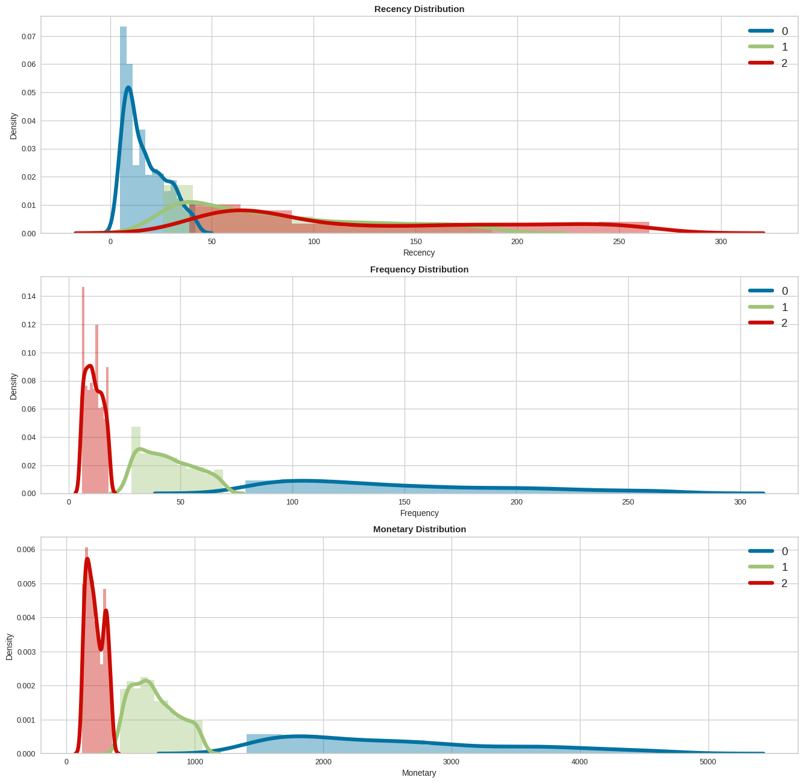
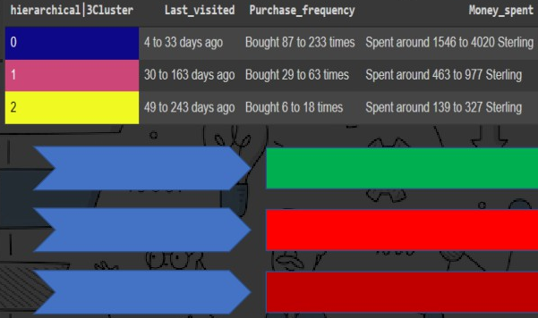
HIERARCHICAL | 3CLUSTER
RECENCY
GROUP 0
BEST CUSTOMERS
FREQUENCY
GROUP 1
LOSING LOYAL CUSTOMERS
GROUP 2
LOST POOR CUSTOMERS
MONETARY

Slide 40
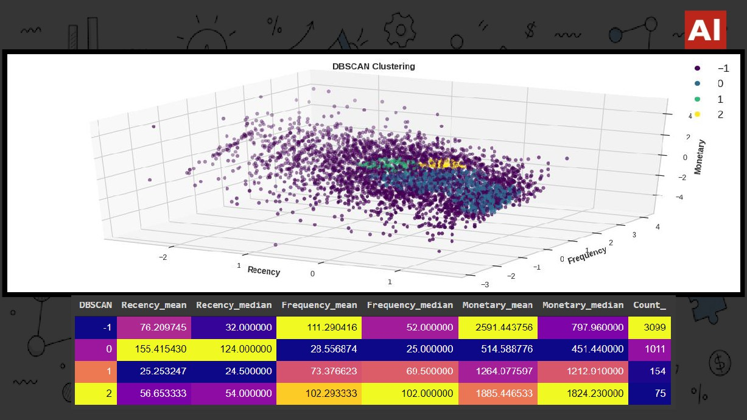
DBSCAN

Slide 41
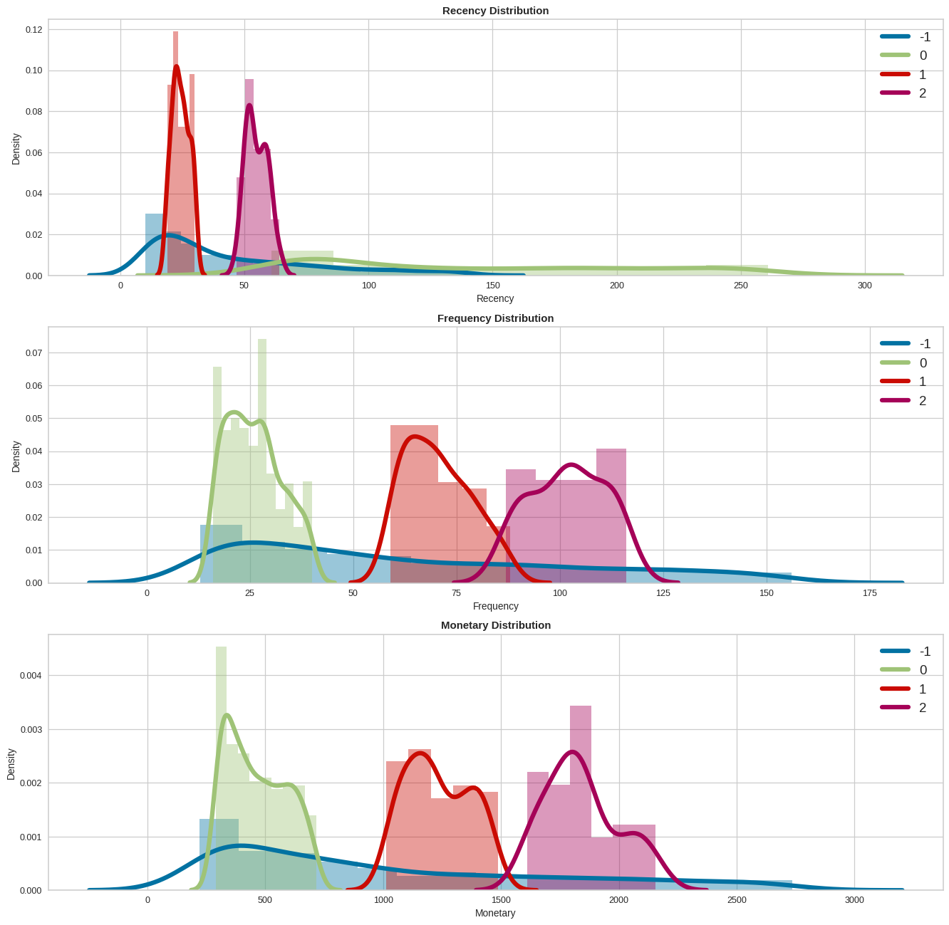
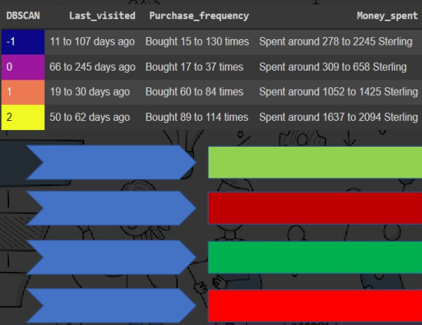
DBSCAN
RECENCY
FREQUENCY
GROUP -1 AVERAGE CUSTOMERS
GROUP 0 LOST POOR CUSTOMERS
GROUP 1 GOOD CUSTOMERS
MONETARY
GROUP 2 LOSING LOYAL CUSTOMERS

Slide 42
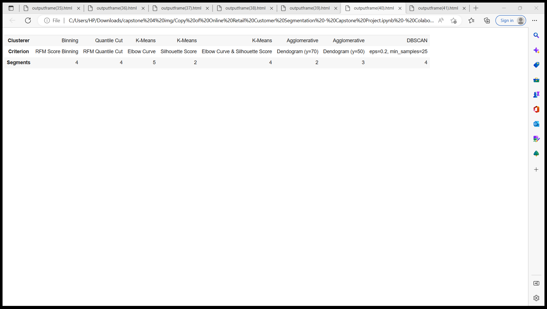
SUMMARY
▪ We started with a simple binning and quantile based simple segmentation model first then moved to more complex
models because simple implementation helps having a first glance at the data and know where/how to exploit it better. ▪ Then we moved to k-means clustering and visualized the results with different number of clusters. As we know there is no assurance that k-means will lead to the global best solution. We moved forward and tried Hierarchical Clustering and DBSCAN clusterer as well.
▪ We created several useful clusters of customers on the basis of different metrics and methods to cateorize the
customers on the basis of their behavioral attributes to define their valuability, loyalty, profitability etc. for the business.
Though significantly separated clusters are not visible in the plots, but the clusters obtained is fairly valid and useful as per the algorithms and the statistics extracted from the data.
▪ Segments depends on how the business plans to use the results, and the level of granularity they want to see in the clusters. Keeping these points in view we clustered the major segments based on our understanding as per different
criteria as shown in the summary dataframe.

Slide 43
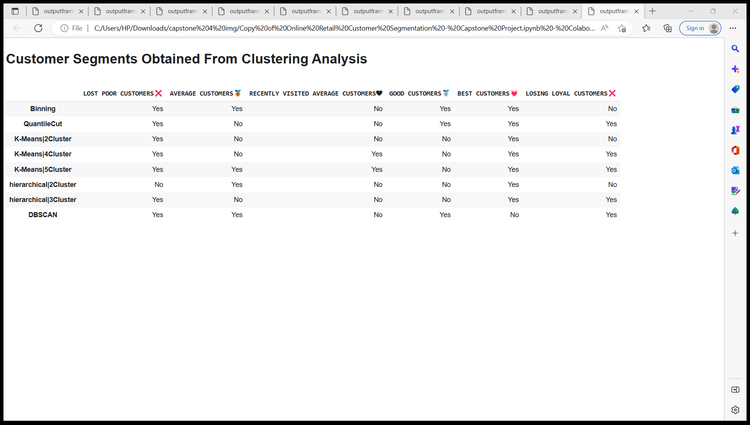
FINAL CONCLUSION
CUSTOMER SEGMENTS OBTAINED FROM CLUSTERING ANALYSIS

